Slide 1
It’s The Road, Not The Drivers

Slide 2
The Problem
Complaints about speeding and running of
stop signs
Old Dobbin Road

Slide 3
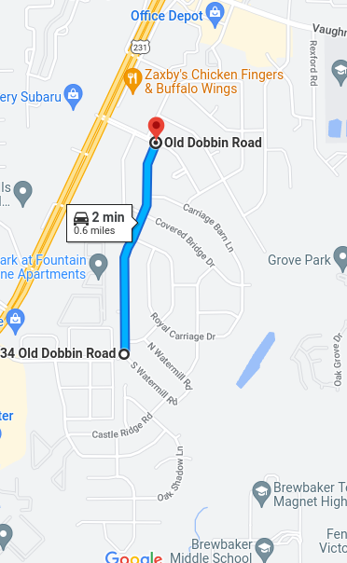
Why Old Dobbin?
Notes:
asdfasdf

Slide 4
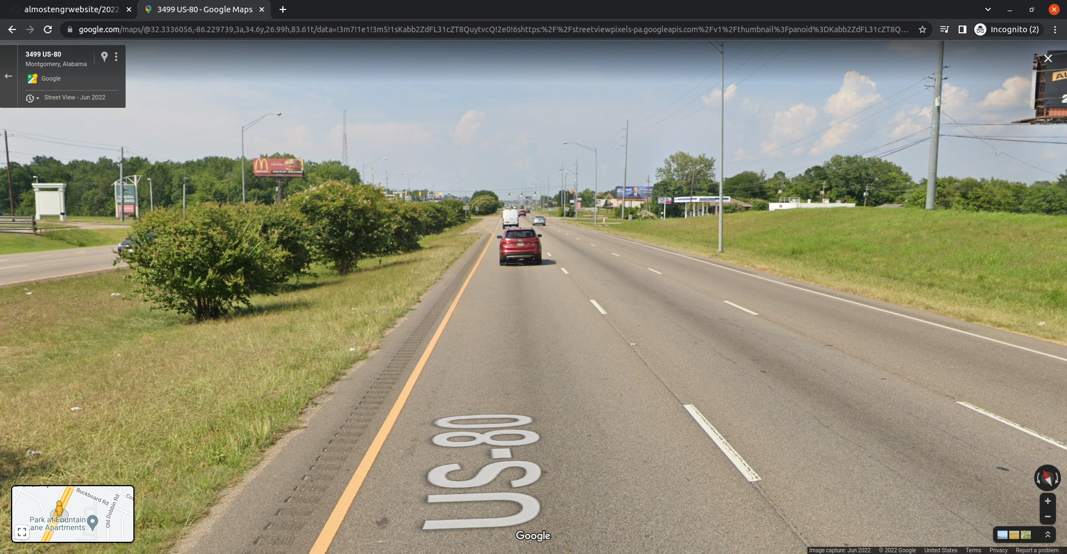
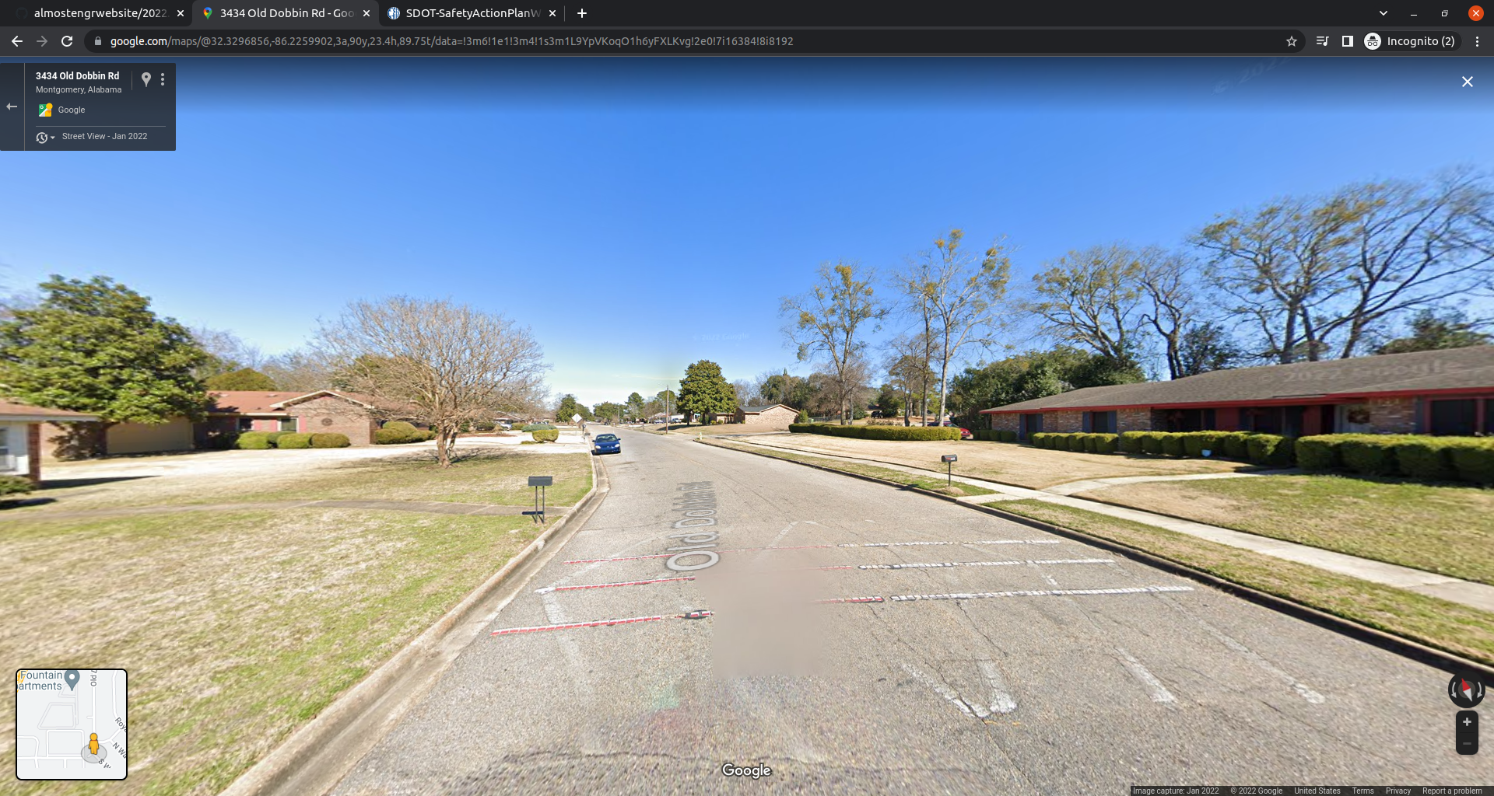
These Roads Are The Same

Slide 5
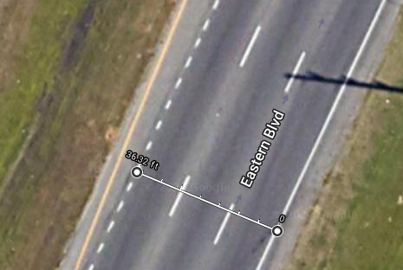
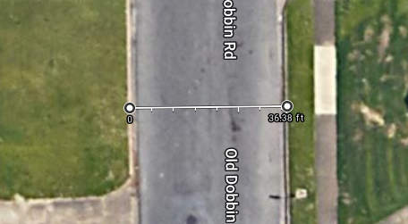
See… Same Measurements

Slide 6
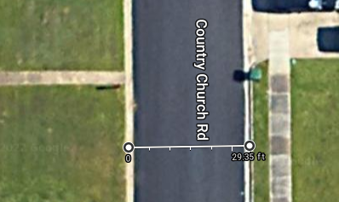
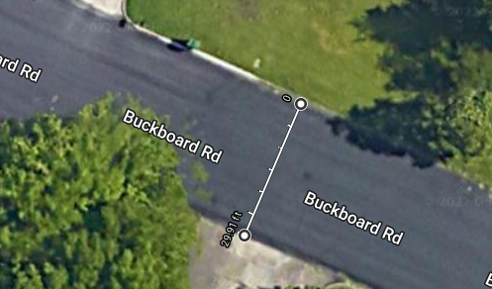
Frame Of Reference

Slide 7
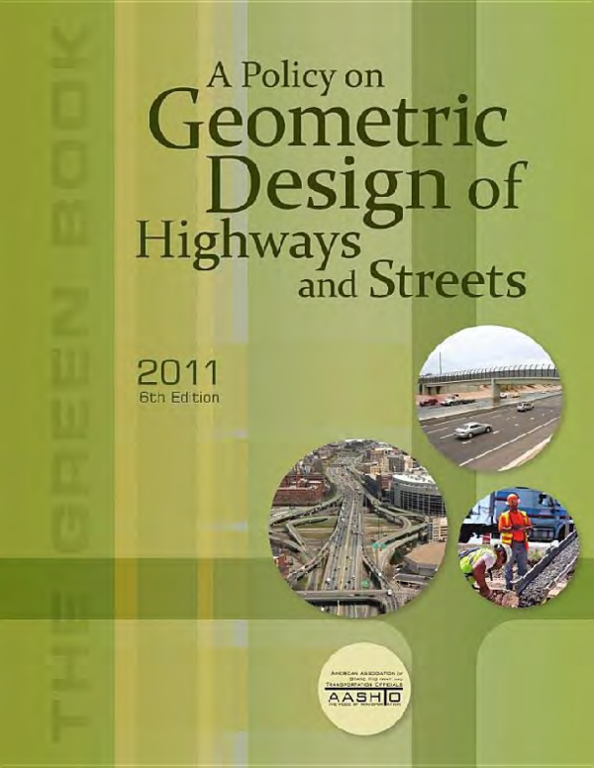
Origin Of The Problem
Source: academia.edu

Slide 8
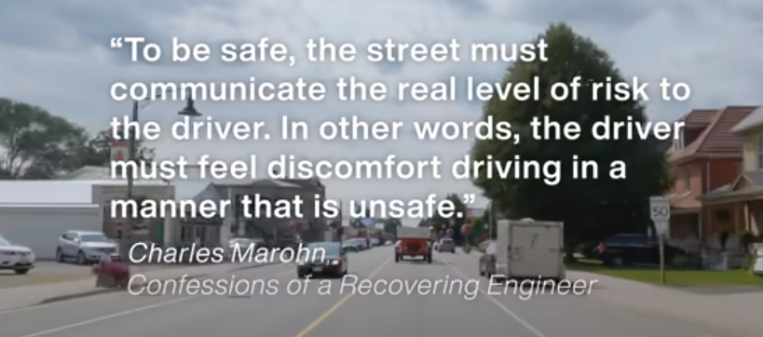
Confessions of A Recovering Engineer
Source: Not Just Bikes

Slide 9
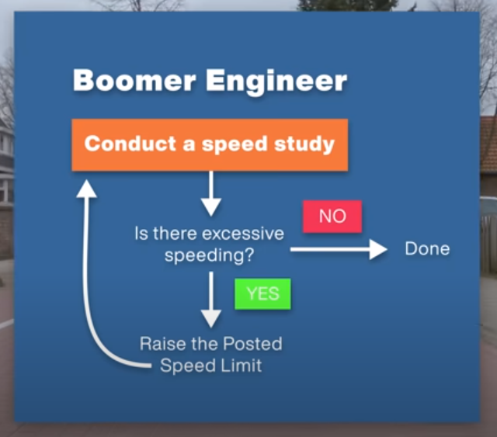
Old Way For Speed Limits
Source: Not Just Bikes

Slide 10
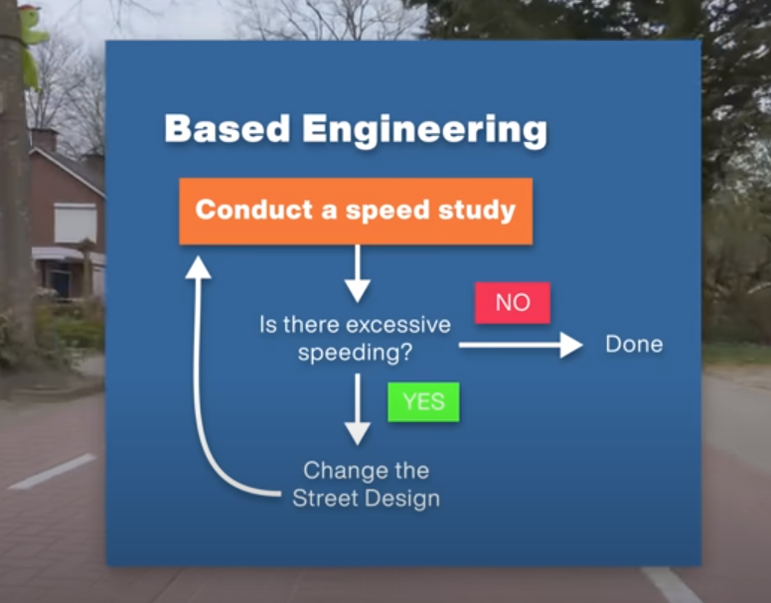
New Way For Speed Limits
Source: Not Just Bikes

Slide 11
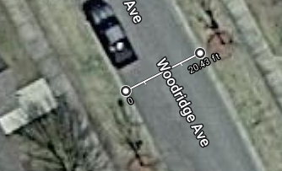
Meanwhile in Pike Road

Slide 12
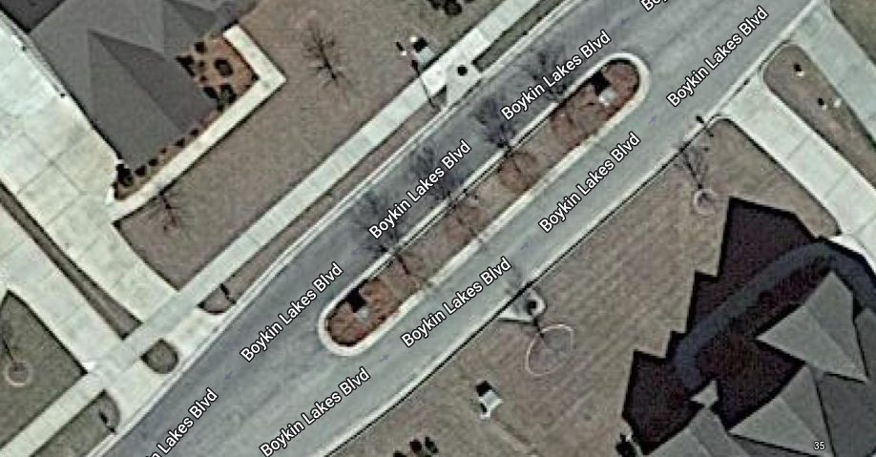
Down The Street in Pike Road

Slide 13
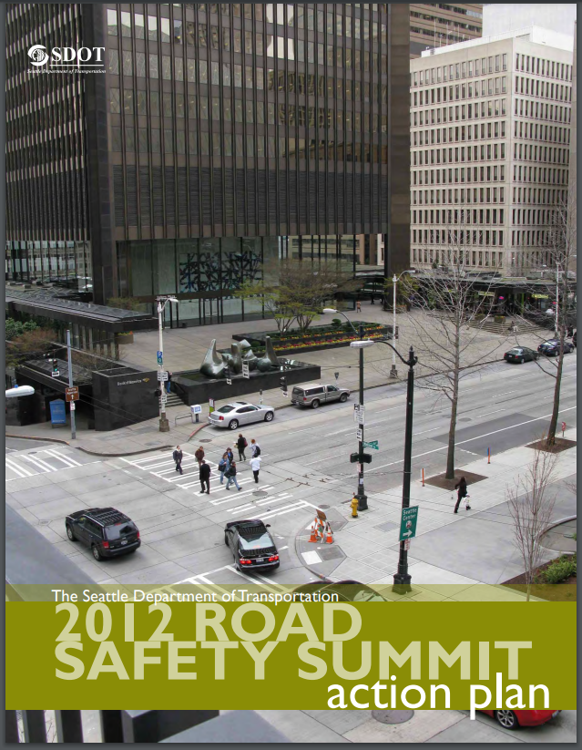
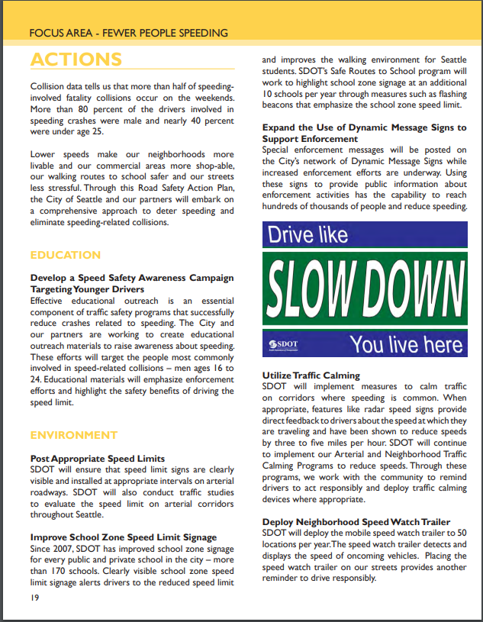
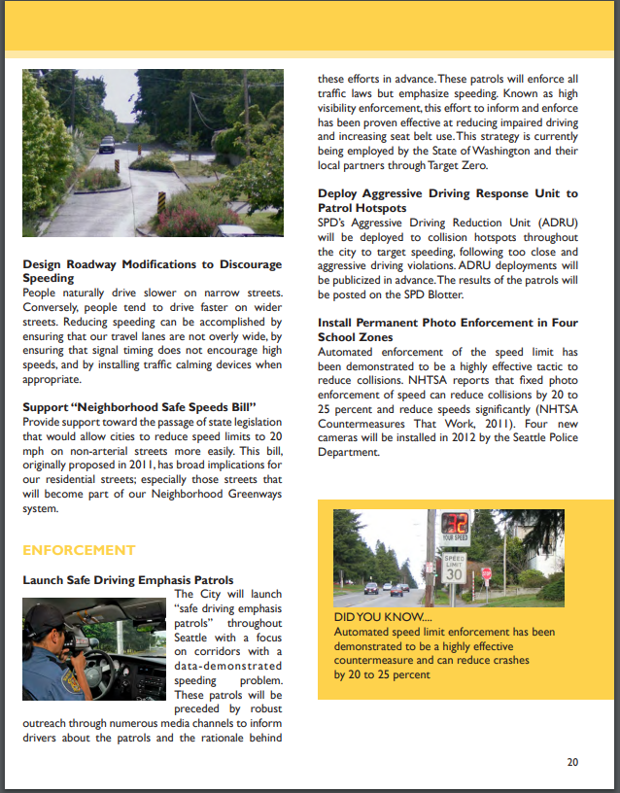
What Seattle Did

Slide 14
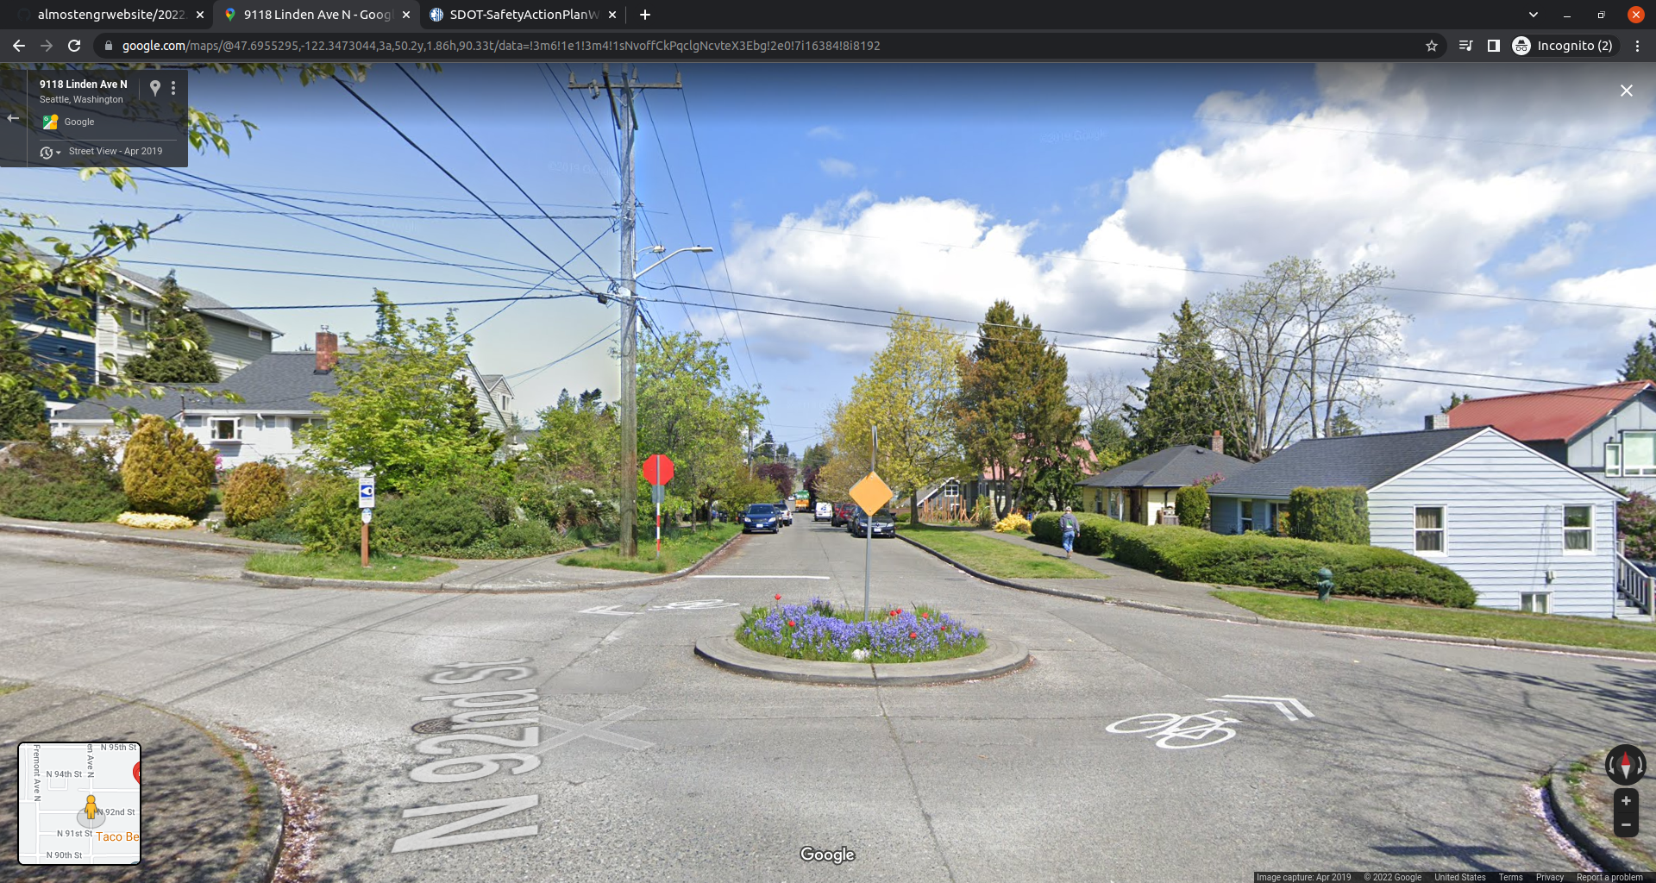
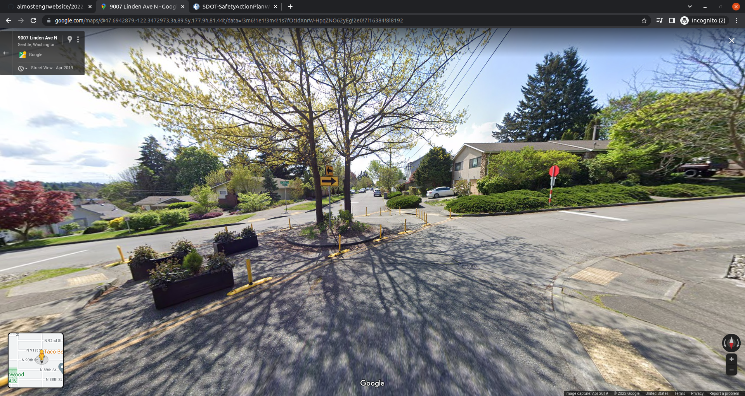
What Seattle Did

Slide 15
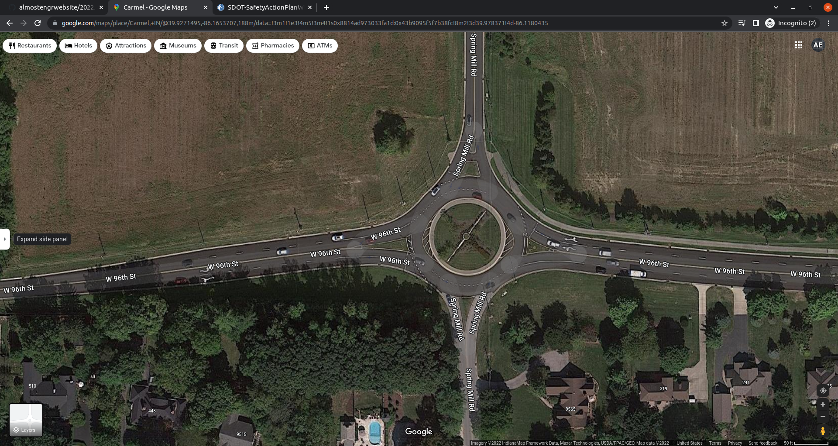
Go Around To Carmel, IN

Slide 16
Conclusion
Residential roads need redesign, especially
Old Dobbin Rd
More physical objects to slow speeding drivers
Leverage knowledge from previous decades

